Slide 1
AI × MARKETING WORKSHOP
The AI Integration
Framework
for marketers.
Where the industry is heading. What you do tomorrow.
PRESENTED BY
Zeeshan Bashir
zeeshanbashir.com
Notes:
Welcome the room. ~30 seconds.
OPENING: 'Today is a workshop, not a lecture. The shape of it: we start with where the marketing industry is heading — because if you don't see the wave, you won't ride it. Then we look at the framework behind every good AI product (BUILD). Then we land on the practical workflow you can use tomorrow.'
Pacing note: ~45 minutes total. 3 interactive breaks. Workshop, not talk.

Slide 2
WHO'S TALKING
Hi, I'm Zeeshan.
I am a Growth Professional
I build AI marketing workflows.
I document what works.
I share what I learn.
Today: a workshop. Not a lecture.
02
Notes:
30–45 seconds. Warm and brief.
SCRIPT (customize): 'I'm exploring AI x brand marketing. Not a guru, not selling anything. I've been documenting AI workflows for [X months] and what I've learned is the framework matters more than the tools. That's what we'll get to.'

Slide 3
BIG QUESTION
Is AI an invention?
Or a discovery?
INVENTION
DISCOVERY
Built for a job.
Found, then explored.
Like a hammer. You know what it does.
Like electricity. We're still finding uses.
If it's a discovery — your job is to explore.
03
Notes:
PROVOCATIVE FRAMING — 2 min. Reorients how they think.
SCRIPT: 'Quick philosophical question. The steam engine = invention, designed for a specific job. Electricity = discovery, we knew it existed before knowing what to do with it. AI is more like electricity. We invented the *technique* — transformer architecture, training methods, RLHF. But the capabilities? Those surprised the researchers themselves. Nobody DESIGNED GPT to write poetry. Nobody DESIGNED Midjourney to do fashion editorials. It just... could.'
'Why this matters for marketers: if AI is an invention, you use it the way the maker intended. If it's a discovery, the playing field is open. You ask: what could this do for my brand that nobody has tried yet?'
LAND: 'If it's a discovery, your job isn't to follow a manual. It's to explore.'

Slide 4
WHY WE'RE HERE
By the end of this workshop
you will be able to:
See where the industry is going.
Speak the language of AI products.
Build one workflow for your portfolio.
04
Notes:
Read aloud. Backward design — destination first.
SCRIPT: 'Three outcomes. One — you'll see the trajectory the marketing industry is on, so you stop reacting and start anticipating. Two — you'll speak AI fluently (LLM, generative, agentic — all by next slide). Three — homework is to build one real workflow. That's the portfolio piece.'

Slide 5
VOCABULARY · 90 SECONDS
What even is AI?
MODEL
LLM
Math that learned a pattern.
A model that learned words.
Recognizes a cat in a photo.
ChatGPT. Claude. Gemini.
GENERATIVE AI
AGENTIC AI
It creates, not just classifies.
It acts, not just answers.
Midjourney makes images.
Books your flight for you.
05
Notes:
VOCABULARY PRIMER — 90 seconds. Demystify, don't lecture.
MODEL — math that learned a pattern. The pattern can be: recognize cats, predict words, classify emails. The model is just numbers in a file.
LLM — a model that learned language. ChatGPT, Claude, Gemini are LLMs.
GENERATIVE AI — creates new content. Not 'is this spam' but 'write me a caption' or 'make me an image'. Midjourney, GPT, Suno, Sora.
AGENTIC AI — takes actions. Not 'tell me the best flight' but 'book it, send invite, email my team'. Claude Code, ChatGPT agents, Devin.
FROM DOC: 'Base LLM is the brain. Tools are how it touches the world.'

Slide 6
PICK YOUR TOOL · 90 SECONDS
AI isn't one thing.
It's a toolbox. Pick right.
CLAUDE
CHATGPT
GEMINI
Long writing. Nuance.
Reasoning. General use.
Image + video + Google.
PERPLEXITY
MIDJOURNEY
RUNWAY
Live web research.
Editorial visuals.
Image → video.
One knife for everything = bad chef.
06
Notes:
DIFFERENT MODELS, DIFFERENT STRENGTHS — 90 seconds. This slide stops people from treating 'AI' as a single thing.
FROM THE DOC, the kitchen analogy: 'It is like a kitchen. You do not use one knife for everything. Chef's knife for chopping, paring knife for detail, serrated for bread. Same principle for models.'
Walk each card in ~10 seconds:
CLAUDE (Anthropic) — long context, nuanced writing, safety-sensitive tasks. Best for: brand voice, long-form, anything where tone really matters.
CHATGPT (OpenAI) — general reasoning, broad world knowledge, coding, mature tooling. Best for: most everyday tasks, the swiss army knife.
GEMINI (Google) — multimodal (text + image + video), Google ecosystem. Best for: anything that needs to read an image, watch a video, or live in Google Workspace.
PERPLEXITY — purpose-built for web research with citations. Best for: trend research, competitor scans, anything where you need a source link.
MIDJOURNEY — editorial visuals, moodboards, campaigns. Best for: high-end fashion-style imagery. (Imagen, FLUX are competitors.)
RUNWAY — image-to-video, motion content. Best for: turning a static product shot into a 5-second TikTok hook.
ALSO WORTH KNOWING (don't put on slide):
• Llama / Mistral / DeepSeek — open-source, self-hosted, cheap.
• Whisper — audio transcription.
• Suno — music.
KEY POINT: Mature AI products don't pick one. From the doc: 'Copy.ai uses Claude, GPT, and Sonar — choosing the best model per task. This is called model orchestration.' So when we talk about workflows later, remember: each step might use a different model. That's the point.
TRANSITION: 'OK, so we've defined AI broadly and seen the toolbox. Now let's go deeper on the most powerful kind of AI — agents.'

Slide 7
GOING DEEPER · AGENTIC AI
So what's actually
an AI agent?
“
Software that uses AI to pursue a goal — autonomously or assisted — by breaking it into tasks, monitoring progress, and using tools and other agents to get it done.
DHARMESH SHAH · Co-Founder & CTO, HubSpot
07
Notes:
AGENTIC AI DEEP-DIVE — 90 seconds. The Dharmesh Shah definition is the cleanest one out there.
READ THE QUOTE OUT LOUD. Then unpack the three highlighted phrases:
1. PURSUE A GOAL — not a single task. Not 'write me a caption.' But 'launch this drop in three markets within 48 hours.' Goal, not chore.
2. BREAKING IT INTO TASKS — the agent decomposes. It figures out: research the markets, draft copy, generate visuals, set up ads, schedule posts. You didn't list those steps. It did.
3. TOOLS AND OTHER AGENTS — it doesn't just think, it acts. It calls APIs, queries databases, hands work off to specialist agents. It's the BUILD framework's DELEGATE layer in one sentence.
MARKETING EXAMPLE: 'Launch a Mother's Day campaign in 5 markets, $5K budget' → agent does the rest. You set the goal. It does the work.
FROM HUBSPOT: This is why Shah keeps saying agents will be the next billion-dollar category. Software that takes goals, not tickets.

Slide 8
THE PARADOX
AI is powerful.
AI is limited. Both true.
Six limitations every marketer should know.
KNOWLEDGE
MEMORY
REASONING
Knows training. Not today.
Forgets when the page fills.
Weak at multi-step logic.
LEARNING
PURPOSE
TOOLS
Doesn't get smarter from you.
No goals. Just responses.
Needs them to touch the world.
08
Notes:
THE 6 LIMITATIONS — 2 minutes. Don't dwell, the next slide picks the most dangerous one.
Walk through each in 15 seconds:
1. KNOWLEDGE — bounded by training data and a fixed cutoff date. ChatGPT doesn't know what happened today.
2. MEMORY — short-term. Conversations exceed the 'context window' (the whiteboard) and earlier info falls off the edge. The Intercom example: customer references order #12345 early, model forgets by message 30.
3. REASONING — historically weak at multi-step logic. Improving with reasoning models (o1, Claude with extended thinking) but still your job to scaffold the thinking.
4. LEARNING — doesn't update itself from talking to you. After deployment, it's static. Every conversation starts fresh unless YOU build the memory layer.
5. PURPOSE — no agency, no goals. Just responds to prompts. (Until you give it agency via the agentic layer we just defined.)
6. TOOLS — the base model can't browse the web, send an email, or update a CRM. It needs external tools.
FROM THE DOC: 'These are limitations of the BASE model. The product magic is in what you build around it.' This is exactly why BUILD has Upgrade, Improve, Lead, Delegate layers — each one fixes specific limitations.

Slide 9
ZOOM IN · THE BIG ONE
The most dangerous one:
Hallucination.
OFTEN OK
OFTEN FATAL
Brainstorming. Captions.
Pricing. Specs. Claims.
Moodboards. First drafts.
Health. Legal. Money.
Variation is the feature.
Confidently wrong = lawsuit.
09
Notes:
HALLUCINATION DEEP-DIVE — 90 seconds. From Reforge knowledge limitations section.
WHAT HALLUCINATION ACTUALLY IS (from the doc): LLMs use probabilistic pattern matching, NOT factual retrieval. They will ALWAYS predict the next word — even when the underlying probability is weak. So sometimes they invent plausible-sounding nonsense with full confidence.
WHY IT MATTERS FOR MARKETERS: AI will tell you with total confidence that your competitor launched a campaign that never existed. That your customer wrote a review they didn't. That a stat from a fake report says what they want it to say.
THE TWO-COLUMN FRAMING (from doc — when hallucination is tolerable vs not):
OFTEN OK — brainstorming, ideation, first drafts, moodboards, varied creative output. Hallucination = variation, which is a FEATURE not a bug. Midjourney 'hallucinates' every image. That's why it works.
OFTEN FATAL — anything with specific facts, prices, product specs, health claims, legal statements. Examples from the doc: Rippling (HR policy), Deel (contracts), Ramp (expense categorization) all use LOW temperature (0) to minimize hallucination.
THE MARKETER'S RULE: 'AI for the first 80%. Human for the last 20%.' Never publish a number, a stat, a quote, or a competitor reference that AI gave you without verifying it.
TRANSITION: 'So if AI has six big problems, how does anyone build anything real with it? Answer on the next slide.'

Slide 10
THE FIX
Every limitation
has a workaround.
KNOWLEDGE
→
RAG. Web search. Live data.
MEMORY
→
Short-term + long-term memory.
REASONING
→
Chain-of-thought prompts.
LEARNING
→
Feedback loops. Fine-tuning.
PURPOSE
→
Agents. Goal-setting.
TOOLS
→
APIs. Plugins. The internet.
This is what BUILD's UPGRADE layer is for.
10
Notes:
HOW WE FIX EACH LIMITATION — 2 minutes. This is the bridge to the BUILD framework.
Walk each row in ~20 seconds:
KNOWLEDGE → RAG (Retrieval-Augmented Generation). Instead of relying on training data, the AI looks up relevant info from YOUR documents, YOUR database, or live web search before answering. ChatGPT with web browsing is RAG. Perplexity is RAG. Brand example: a chatbot that knows YOUR product catalog instead of guessing.
MEMORY → short-term (chat history) + long-term (vectorized 'memories' it can retrieve). From the doc: Buffer memory = full transcript. Summary memory = running notes. Entity memory = CRM for the AI. Knowledge Long-Term Memory = RAG for memories.
REASONING → Chain-of-Thought prompting. Force the AI to show its work. Instead of 'is this product right for this customer?' you ask 'walk through: who is the customer, what are their needs, what are the product's features, do they match?' Accuracy jumps 20-30% (from the doc).
LEARNING → Reinforcement Learning from Human Feedback (RLHF). Fine-tuning. Your team rates outputs, AI learns what 'good' looks like for your brand.
PURPOSE → Agents. Give the AI a goal (not a prompt), the tools to use, and boundaries. Then it figures out how to get there. (Refer back to the Dharmesh Shah definition we just covered.)
TOOLS → APIs, plugins, MCP servers, browser access. The AI can now look something up, send an email, book a meeting, update a record.
BIG TAKEAWAY: This is literally the BUILD framework's UPGRADE layer. We're about to go through BUILD in detail. So this slide is the WHY behind why BUILD exists.
TRANSITION: 'Now hold all of that. Big philosophical question coming next.'

Slide 11
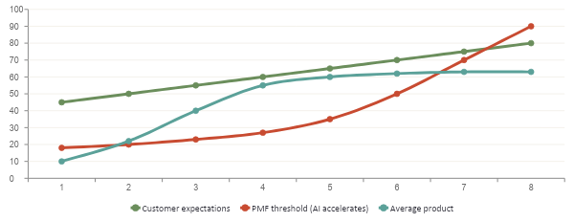
THE INDUSTRY SHIFT
The PMF treadmill.
Product-market fit used to be a milestone.
Now it's a moving target — and AI just sped it up.
WHAT'S NEW
Internet shift: years.
Mobile shift: years.
AI shift: months.
Source: Reforge
11
Notes:
PMF TREADMILL — 2 min. This is THE big-picture industry slide.
FROM REFORGE: PMF isn't a milestone you hit — it's a treadmill you stay on. The PMF threshold (the bar customers expect you to clear) keeps rising. AI just slammed the accelerator on the treadmill.
READ THE CHART OUT LOUD:
• GREEN line — what's POSSIBLE for the customer (peak value).
• ORANGE line — what customers EXPECT (PMF threshold). Used to rise gradually. Now it inflects sharply once AI shows up.
• TEAL line — average company performance. Plateaus. Falls behind.
WHY IT MATTERS FOR MARKETERS: Brands that used to compete on 'we have decent content' suddenly look slow next to brands using AI to personalize at scale. Your competitor isn't just other brands — it's customer expectations themselves.
Next slide: two real stories of brands that fell off the treadmill.

Slide 12
PMF COLLAPSE
What falling off
the treadmill looks like.
STACK OVERFLOW
CHEGG
40%
80%
traffic drop. Months, not years.
market value gone. 12 months.
Devs left for instant ChatGPT answers.
Students switched to free AI tutors.
No grace period. The window slams shut.
Source: Reforge
12
Notes:
2 minutes. From Reforge.
STACK OVERFLOW: 15 years, every developer's first stop. ChatGPT launched. Reports show ~40% traffic decline in developer-heavy markets within months. Devs got instant contextual answers instead of waiting for community.
CHEGG: Homework-help subscription. Lost 80%+ market value in <12 months. Half a million subscribers gone. Students switched to free AI homework help with a better experience.
KEY LESSON FOR MARKETERS: Any brand whose value is information access, or being a tool to create, or doing manual work — is on the AI clock.
FROM REFORGE: 'No grace period. The window slams shut before companies even recognize the threat.'

Slide 13
WHAT CUSTOMERS NOW EXPECT
Four shifts you're
already being judged on.
Tool to create
→
Do it for me
I customize
→
Built for me
Midjourney over Photoshop
TikTok over signing up
Manual tasks
→
Automated tasks
Pay for access
→
Pay for outcomes
Abridge over typing notes
Intercom per resolution
Source: Reforge
13
Notes:
CUSTOMER EXPECTATION SHIFTS — 2 minutes. The most marketing-relevant slide so far.
FROM REFORGE, four shifts in value expectations:
1. 'Tool to create' → 'Do it for me'
• Photoshop required skill. Midjourney needs a prompt.
• EvenUp drafts legal letters instead of lawyers writing them.
• For marketing: customers don't want a content tool — they want the content.
2. 'I customize' → 'Built for me'
• CRMs used to require months of setup. Day.AI builds a CRM from your email.
• TikTok skipped the 'pick your interests' step — it just learns.
• For marketing: every customer touchpoint should feel pre-personalized.
3. 'Manual tasks' → 'Automated tasks'
• Doctors typing notes → Abridge auto-generates from conversations.
• Sales reps typing CRM data → Day.AI listens to calls and updates records.
• For marketing: any repetitive task customers see is a liability.
4. 'Pay for access' → 'Pay for outcomes'
• EvenUp charges per demand letter generated.
• Intercom: per AI resolution, not per seat.
• Synthesia: per minute of video created.
• For marketing: pricing pages are getting rewritten across the industry.
(Speed + UX shifts also matter — covered in next slide via real numbers.)

Slide 14
PROOF FROM FASHION
It's already
happening to your brands.
70%
4×
1
of Zalando ads
Mango revenue
AI model
AI-generated.
from AI ads.
in Vogue, 2025.
14
Notes:
60-90 seconds. Bring it home — fashion is on the treadmill too.
70% — Zalando, Q4 2024: 70% of campaign images AI-generated. Digital twins of 30 real models, consent-based. Production time: 6–8 weeks → 4 days.
4× — Mango quadrupled social ad revenue with Smartly. Same team. Different workflow.
1 — Guess put an AI model in Vogue, Aug 2025. Two-page spread, tiny disclaimer. Industry still debating.
PUNCHLINE: 'AI didn't take their jobs. The marketers using AI took their jobs.'

Slide 15
THE LANDSCAPE
Five types of marketing work.
AI is rewriting all five.
01
02
03
04
05
BRAND FIT
CAMPAIGNS
GROWTH
SCALING
EXPANSION
Find your audience.
Extend what works.
Acquire and retain.
Build the systems.
New markets, new audiences.
Adapted from Reforge
15
Notes:
FIVE TYPES OF MARKETING WORK — 90 sec. Adapted from Reforge's Five Types of Product Work.
01 BRAND FIT — finding what resonates. The 0-to-1 of any brand.
02 CAMPAIGNS — extending what works into new seasons, products, audiences.
03 GROWTH — acquisition, retention, lifecycle. Loops that compound.
04 SCALING — building the systems so the marketing machine doesn't break.
05 EXPANSION — new geographies, new categories, new audiences.
KEY POINT: Most marketers use ONE playbook for everything. That's the hammer-and-nail problem. Each type of work needs its own approach. And AI is rewriting all five.
FROM REFORGE: 'AI is not a sixth type of work. It's a technology shift that reshapes each one.' For marketers, that means there's no separate 'AI marketing' job — every marketing job is becoming an AI marketing job.
EXAMPLES per type:
Brand fit + AI: faster trend listening, instant audience research.
Campaigns + AI: generate 30 variants from one concept.
Growth + AI: hyper-personalized onboarding, dynamic creative.
Scaling + AI: automated reporting, workflow orchestration.
Expansion + AI: instant localization, market entry without translators.

Slide 16
THE NEW JOB
A marketer has
three core jobs. AI changes each.
01
02
03
UNDERSTAND
PRIORITIZE
FACILITATE
the customer.
what to solve.
the work.
AI hears more, faster.
AI surfaces what matters.
AI does the grunt work.
Adapted from Reforge
16
Notes:
THE THREE MARKETER JOBS — 2 min. Adapted from Reforge's three PM responsibilities.
01 UNDERSTAND THE CUSTOMER
• What you do: hear what customers feel, want, struggle with.
• AI shift: AI listens to thousands of reviews, social posts, support tickets in minutes.
• Example: Canva — non-designers can now create pro visuals. This opens entirely new customer problems you can solve (people who'd never have hired a designer).
• Example: Duolingo — AI generates infinite personalized practice scenarios. Problem space expanded.
02 PRIORITIZE WHAT TO SOLVE
• What you do: decide what's worth your team's time.
• AI shift: AI surfaces patterns humans miss (impact), makes things feasible that weren't (Spotify AI DJ), introduces new risk (hallucination/bias), changes cost math.
• Four prioritization dimensions: feasibility, impact, risk, cost — AI moves all four.
03 FACILITATE THE WORK
• What you do: make the work actually happen.
• AI shift: Ramp auto-categorizes expenses. Grammarly rewrites for tone. Shopify generates product descriptions + SEO from a single photo. Marketing grunt work disappears.
KEY POINT: AI didn't replace these three jobs. It expanded what's possible inside each. The marketers who win lean INTO this expansion.

Slide 17
PAUSE · 90 SECONDS
Your turn.
Which shift
scares your favorite brand most?
DO IT FOR ME
BUILT FOR ME
AUTOMATED
PAY FOR OUTCOMES
Shout it out. We'll workshop it.
17
Notes:
FIRST INTERACTIVE BREAK — ~12-13 min in. 90 seconds.
HOW TO RUN: 'Pick a brand you love. Which of these four shifts is going to hit them hardest in the next 12 months?' Call each option, take a quick vote.
ASK ONE STUDENT: Name the brand and why. 20 seconds.
If quiet: 'Take Sephora. Customers don't want a tool to find products — they want the products picked for them. Which means: Do It For Me hits them hardest.'
Transitions into: 'OK so we've seen WHERE the industry is going. Now: HOW do AI products actually work behind the scenes?' → BUILD framework.

Slide 18
THE FRAMEWORK
How AI products
actually get built.
01
02
03
04
05
BASE
UPGRADE
IMPROVE
LEAD
DELEGATE
Raw AI capability.
Add knowledge, tools, memory.
Learn from feedback.
Goals and autonomy.
Multi-agent teams.
Most teams stop at BASE. The winners climb.
Source: Reforge
18
Notes:
BUILD FRAMEWORK REVEAL — 2 minutes. This is THE framework from your study material (Reforge). Five layers, bottom to top.
BASE — raw AI capability. LLMs, foundation models. ChatGPT out of the box.
UPGRADE — add knowledge, tools, memory. Now it knows your brand voice, can search the web, remembers past conversations.
IMPROVE — feedback loops. RL, human feedback, fine-tuning. It gets sharper over time.
LEAD — autonomy. Set a goal, the AI decides how to reach it.
DELEGATE — multiple specialized AIs working together. An AI team.
ANALOGY (from Reforge): Like hiring an employee.
• Base = hire smart person
• Upgrade = train them with skills and tools
• Improve = give performance reviews
• Lead = assign goals, give ownership
• Delegate = build a team
KEY POINT: 95% of marketers use AI at the BASE layer (ChatGPT for captions). The value is in climbing — and the next slide shows what that looks like in marketing.

Slide 19
BUILD × MARKETING
What each layer
looks like in marketing.
01
BASE
Generic AI captions.
02
UPGRADE
Brand voice + customer data.
03
IMPROVE
Track CTR. AI gets sharper.
04
LEAD
AI plans the whole campaign.
05
DELEGATE
AI team: research + content + ads.
Framework: Reforge · Examples by Z. Bashir
19
Notes:
BUILD APPLIED TO MARKETING — 2 minutes. Walk through each layer with a marketing lens.
01 BASE — Generic AI captions.
Just ChatGPT, no context. Output is average. Sounds like everyone else.
02 UPGRADE — Brand voice + customer data feeding in.
Now AI knows your brand. Captions match your tone. Image prompts respect your aesthetic. This is where most 'good' AI marketing lives.
03 IMPROVE — Track CTR. AI gets sharper.
Feed performance back. AI learns which hooks work, which don't. Each campaign is built on the last campaign's lessons.
04 LEAD — AI plans the whole campaign.
You give it a goal: 'launch this drop in 5 markets, $10K budget, target 18-24.' AI plans channels, writes copy, designs creative, sets bids. You review.
05 DELEGATE — AI team: research + content + ads + analytics.
Multiple specialized AIs working in coordination. One for trend research, one for content, one for ad optimization, one for reporting. They hand off automatically.
FROM THE DOC: 'Stop at Base = just using ChatGPT. Real value is Improve, Lead, Delegate.'
ASK THE ROOM: 'Honest gut check — what layer are YOU at right now?' Pause. Let them think.

Slide 20
THE HONEST TRUTH
One AI tool?
A party trick.
Many tools, working together?
A marketing department.
20
Notes:
Central metaphor. Connects BUILD framework to the workflow that's coming.
SCRIPT: 'If your AI strategy is ChatGPT for captions — that's BASE layer. Party trick. But chain multiple AI tools together with the right workflow — that's UPGRADE → IMPROVE → LEAD → DELEGATE. That's a marketing department.'
ONE-LINER: 'One tool is a capability. Many tools orchestrated is a product.'
TEE UP: 'So what does that sequence look like in practice? Five steps. Coming up.'

Slide 21
PAUSE · 2 MINUTES
Pick a brand.
Turn to the person next to you.
Pick one fashion brand.
What BUILD layer are they at?
Two minutes. Then we share.
21
Notes:
SECOND BREAK — ~25 minutes in. 2 minutes.
HOW TO RUN: 'Pair up. Pick a fashion brand. Where are they on the BUILD ladder — Base, Upgrade, Improve, Lead, or Delegate?'
90-second pair discussion. Call on 2 pairs, 20 sec each.
NUDGE: 'Zara — probably BASE or UPGRADE. They use ChatGPT for descriptions but it still feels generic. Shein — closer to LEAD. They iterate collections in days based on AI signals.'
TRANSITION: 'Great. Now the practical part — how does a marketer actually do this?'

Slide 22
THE WORKFLOW
How a marketer
actually uses BUILD.
01
02
03
04
05
LISTEN
IDEATE
CREATE
DEPLOY
LEARN
It's a loop, not a line.
22
Notes:
60 sec preview. Don't deep-dive.
SCRIPT: 'Five words: Listen, Ideate, Create, Deploy, Learn. This is BUILD applied to a marketing workflow. Each step uses progressively higher BUILD layers.
Listen → research (Upgrade layer with knowledge access)
Ideate → brainstorm (Base + Upgrade)
Create → produce (Upgrade + Improve)
Deploy → ship (Lead — AI takes initiative)
Learn → feedback (Improve — the loop closes)
It loops. That's what makes it compound.'

Slide 23
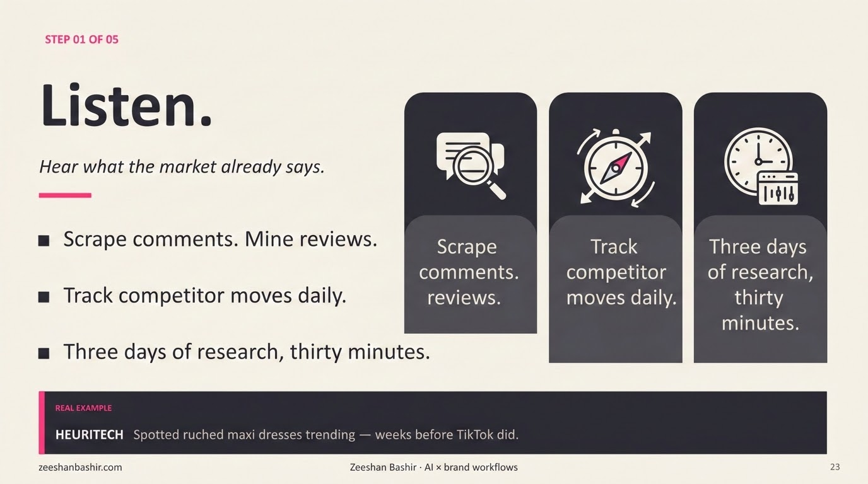

Slide 24
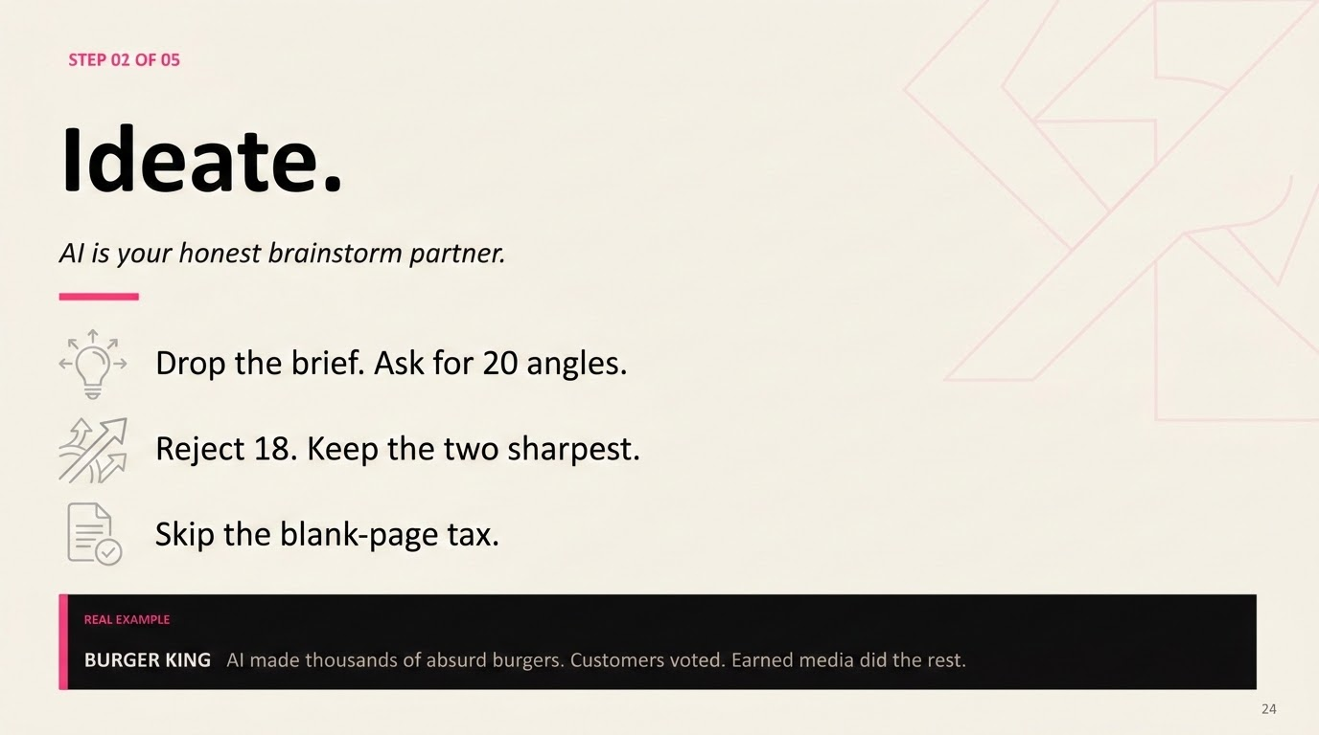

Slide 25
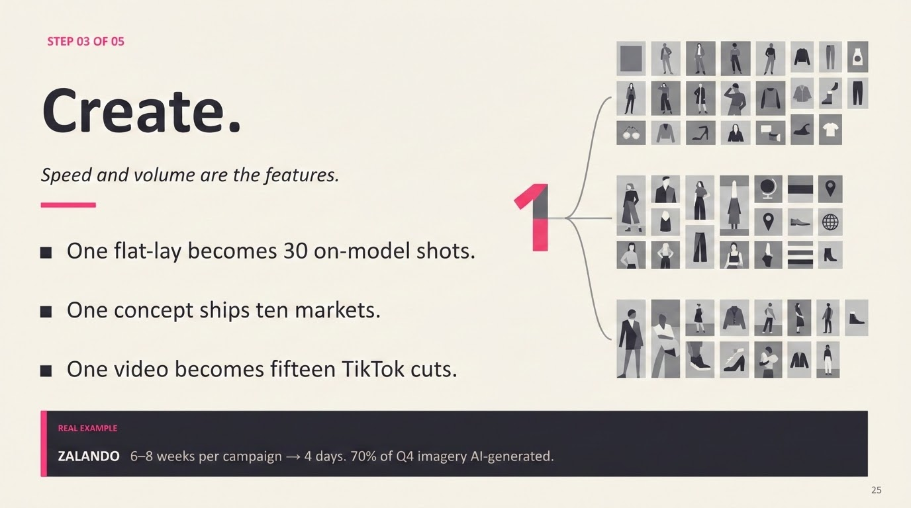

Slide 26
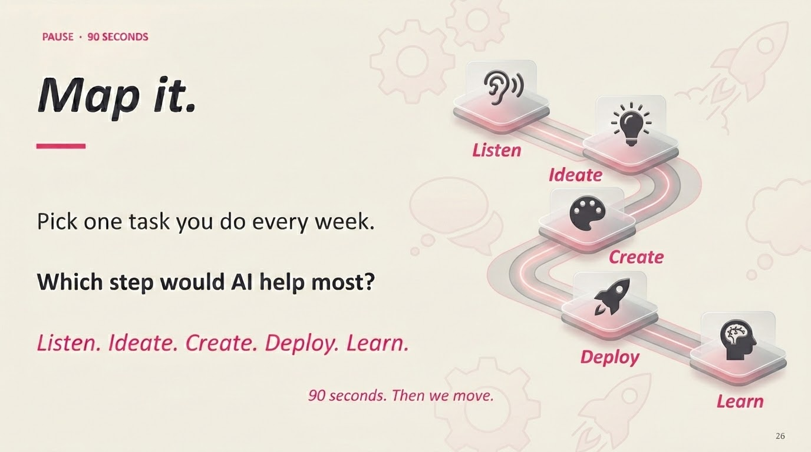

Slide 27
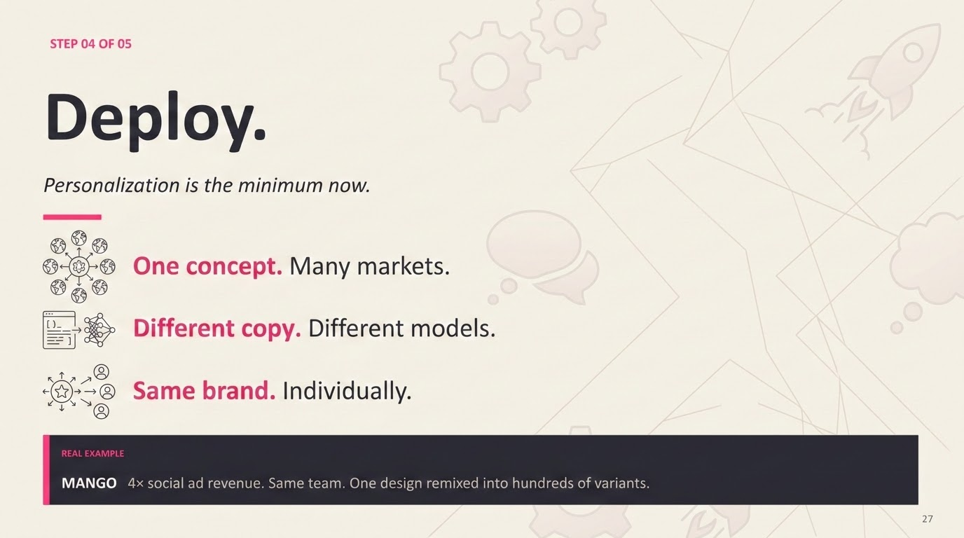

Slide 28
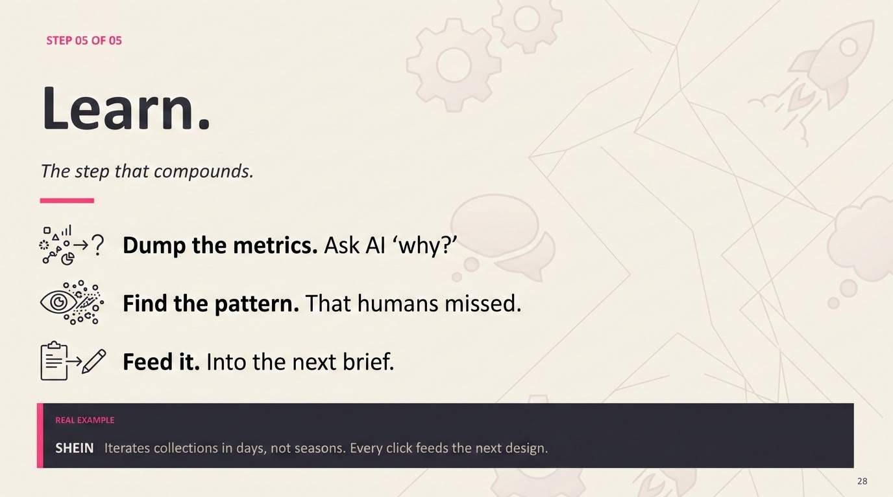

Slide 29
THE BIG IDEA
Your job?
Conduct the orchestra.
You bring taste and judgment.
Tools bring speed and volume.
Workflow brings the magic.
29
Notes:
Closing concept slide. ~90 sec.
FROM DOC: 'Orchestrator is the conductor. Tools are the musicians. Workflow is the symphony.'
SCRIPT: 'Conductor doesn't play any instruments. They don't need to be best at violin. Their job is knowing when each instrument plays, how loud, how long. That's you. Taste + judgment + brand context. Orchestrating tools that individually are decent and together are devastating.'
ONE-LINER: 'Capability scales linearly. Orchestrated capability scales exponentially.'

Slide 30
WHERE ARE YOU?
The maturity ladder.
01
One tool, one task.
02
Many tools, no plan.
03
A real sequence.
04
Parallel workflows.
05
Adaptive systems.
06
Agentic.
Most teams: Lvl 2. Winners: Lvl 4.
30
Notes:
Self-location slide. ~2 min.
From the doc — the tool-use maturity ladder:
Lvl 1 — Single tool, single call. ChatGPT for captions.
Lvl 2 — Many tools, no orchestration. Each task a separate panic.
Lvl 3 — Sequential chain. Tool A → B → C, every time.
Lvl 4 — Parallel + sequential. Variants generated, then matched.
Lvl 5 — Adaptive. Workflow changes based on results.
Lvl 6 — Agentic. Full workflow runs itself, you review.
MAPS TO BUILD: Lvl 1-2 = Base. Lvl 3-4 = Upgrade + Improve. Lvl 5 = Lead. Lvl 6 = Delegate.
ASK: 'Be honest — where are you?' Let them think.

Slide 31
MAKE IT STICK · 3 MINUTES
3 - 2 - 1.
3
main points you'll remember.
2
questions still buzzing.
1
takeaway you'll use tomorrow.
31
Notes:
MAKE MEMORIES — 3 min. Most important slide.
HOW TO RUN:
1. Read the slide out.
2. 'Write it down. Two minutes.'
3. Set timer.
4. Call on 2-3 students for their ONE takeaway only.
3-2-1 is active recall — encodes what they heard, not what I said. Verbal share-out socially commits them to action.
IF SHY: 'I'll start — my one takeaway is: pick one workflow, map it, build it. Now yours.'

Slide 32
END NOTES
Thank you.
Bring your worst question.
I'll bring my best guess.
FIND MY WORK
zeeshanbashir.com
Zeeshan Bashir · AI × brand workflows
32
Notes:
Q&A — ~5 min.
OPEN: 'I'll take any question. Best ones are the ones you think are stupid — they almost never are, and someone else is wondering the same thing.'
IF SILENT: Ask THEM. 'What's one tool you've been curious about but haven't tried?'
BEFORE CLOSING: Remind homework — one workflow, mapped, built before next class.

